Slide 1
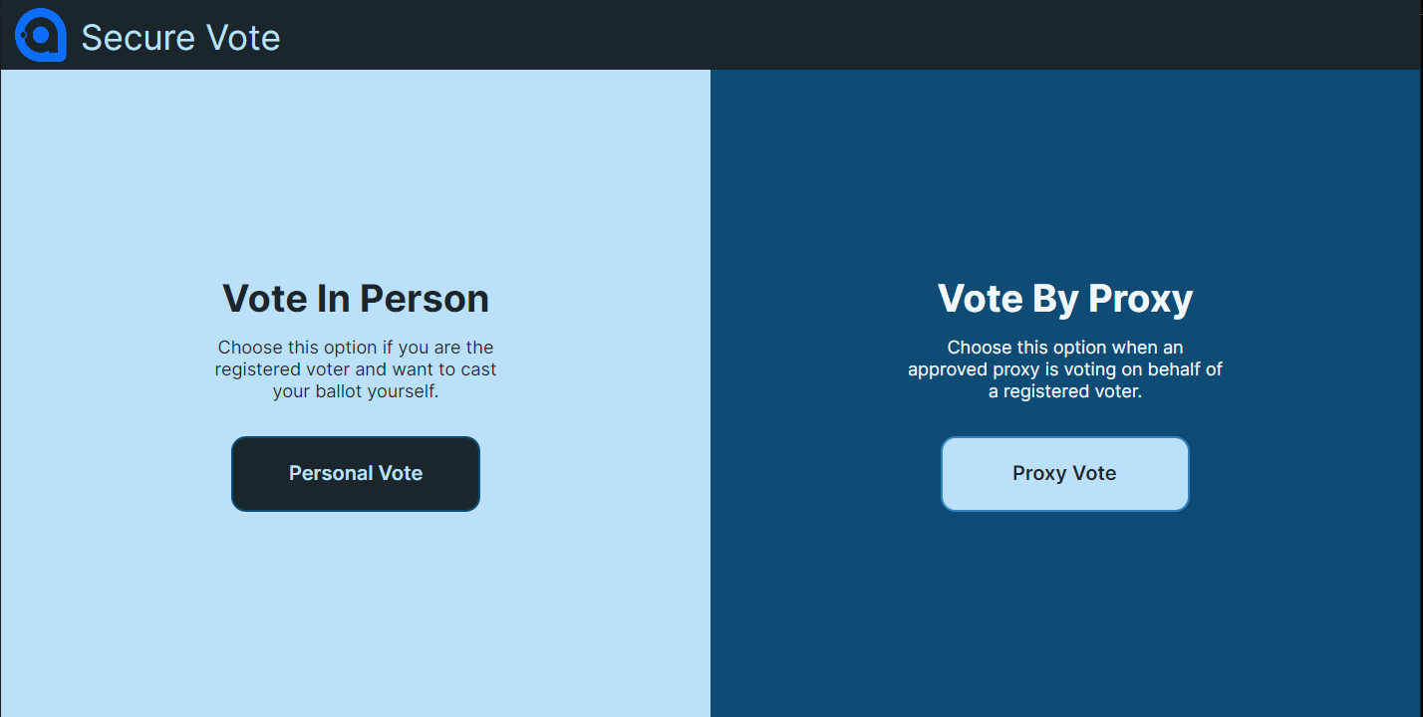
Fingerprint Authenticated E-Voting System
Alexander Gordon
Introduction
Biometric Technology
User Interface
Evaluation and Conclusions
Aims and Objectives
The UK Voting System still relies on paper ballots and manual counting, a system largely unchanged since 1888 [7]. This introduces several well-documented vulnerabilities:
Voter impersonation is difficult to detect under the current name, address, and signature model
Ballot tampering risk arises from physical handling during transportation and counting
Manual counting is slow and costly
Postal voting carries documented risks of undue influence, language barriers, and misrepresentation
Scanner | Cost(USD) | False Acceptance Rate
Iris | $1,500 – $3,000 | 0.0001 – 0.01%
Face | $1,000 – $2,500 | 0.1 – 1.0%
Fingerprint | $200 – $1,500 | 0.01 – 0.1%
The user interface was designed to be intuitive and easy to use. A focus on minimalizing input was used to keep user flow simple and to limit the attack surface
Evaluation of the Methodology
The loose Agile approach proved well suited to solo development, allowing requirements to evolve without disrupting overall progress. The MoSCoW framework ensured core functionality was prioritised from the outset, and iterative supervisor meetings provided structured checkpoints throughout. Its greatest strength was demonstrated when the architectural switch from HTTP polling to SignalR was absorbed mid project without significant disruption to the broader timeline.
Evaluation of the System
The system successfully delivers a fingerprint authenticated voting system with structural ballot anonymity. Both rounds of user evaluation confirmed the voting process is intuitive, and the Official App improved significantly following the redesign. Key limitations remain around GDPR compliant data retention, macOS scanner compatibility, and server scalability beyond 1,000 concurrent connections.
Conclusion
This project successfully demonstrated that a fingerprint authenticated E-voting system can address the structural weaknesses of the UK's paper based voting process. Ballot anonymity is enforced by design, voter identity is verified without forgeable identifiers, and results are produced instantly. While accessibility, scalability, and GDPR compliant data retention require further development, the system presents a credible and secure foundation for biometric E-voting in the UK.
Table of scanner cost and False Acceptance Rate [12][19]
Fingerprint scanning was selected based on:
Most cost-effective option at $200–$1,500 per unit
FAR below 0.1%
Capacitive sensors are significantly more resistant to spoofing than optical alternatives
Real world viability shown by Brazil's national deployment
Thumb selected as primary input for larger surface area
Vote Type Selection Screen From Secure Vote App
Implementation
Database
Voter anonymity enforced structurally as a vote record holds zero reference to voter identity
Every voter’s information and fingerprint is encrypted individually using AES-256-GCM
Voter lookup performed without ever exposing plaintext personal data using SDI
SDI probability of collision is 2.4×10⁻²¹ effectively eliminating duplicate identity risk
Server
Hosted on AWS EC2 with all encryption secrets stored in AWS Secrets Manager
Server EC2 instance is exclusively able to access encryption secrets
Channels used to organise connections are categorised by county and constituency
Sever EC2 instance is the only IP the database is permitted to communicate with
Voter device JWT tokens issued live for 8 hours which is the expected polling station opening times
Potential identical twin issue handled by multiple row fingerprint comparisons
SourceAFIS was used for fingerprint image comparison
Client Applications
Apps were built using Avalonia which allows the system to run on Windows and macOS
MVVM architecture used for clean separated logic between User Interface and backend logic
Scanners Software Development Kit limited to Windows, Linux and Android
Status update are sent constantly between Voter devices and Official
Testing
SourceAFIS Testing
SourceAFIS was tested against two open source datasets. Firstly FVC2002, providing clean fingerprint scans to benchmark performance under ideal conditions, and SOCOFing, containing deliberately damaged fingerprints to challenge the system's ability to reject false positive matches. The test showed that SourceAFIS had a False Acceptance Rate of 0 for both databases, showing that it is a secure software to use in a voting system as it rejects all false matches.
Server Load Testing
A concurrent connection load test was conducted against the live EC2 hosted server, increasing connections across five levels from 100 to 2,000. The server handled up to 964 simultaneous connections reliably, with failures increasing significantly beyond.
References
[12]
R. Alrawili, A. A. S. AlQahtani, and M. K. Khan, “Comprehensive survey: Biometric user authentication application, evaluation, and discussion,” Computers and Electrical Engineering, vol. 119, no. A, p. 109485, Oct. 2024, doi:
[19]
A. Devasia, “Biometric Access Control System Price: Full Guide (2024),” Safe and Sound Security, May 29, 2024. https://getsafeandsound.com/blog/biometric-access-control-system-price/
[7]
E. Hill, M. Sobolewska, S. Wilks-Heeg, and M. Borkowska, “Explaining electoral fraud in an advanced democracy: Fraud vulnerabilities, opportunities and facilitating mechanisms in British elections,” The British Journal of Politics and International Relations, vol. 19, no. 4, pp. 772–789, Jun. 2017, doi: https://doi.org/10.1177/1369148117715222.

